Slide 1

pBuzz l pBone l pTrumpet l just play!

Slide 2

Little Kids Rock
Strategic
Opportunity
Next Generation of Brass Players
Exceptional Access to Education / Teachers
=➔Complimentary Product & Broadening Beginner Offerings
Warwick Music:
Fun – Easy to Play and Maintain - Product Offerings
Education Teaching Resources Focus in UK (& USA)
2
Notes:
National Foundation for Youth Music, funded by the UK Government, declared the trombone to be an “endangered species”

Slide 3
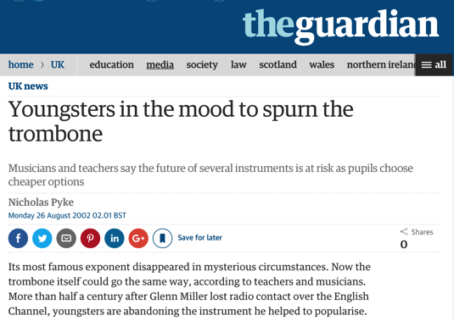
Why plastic instruments began?
Humble
Origins
Trombone officially an “endangered-species”
(UK Government)
A generation of musicians was being lost
Plastic offered unique opportunities to make things easier
3
Notes:
National Foundation for Youth Music, funded by the UK Government, declared the trombone to be an “endangered species”

Slide 4
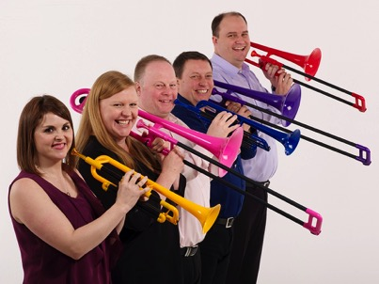
The musicians behind pBone & pTrumpet and now pBuzz
Core
Team
British musicians and parents passionate about music-making
pBone: Designed and developed in the UK from 2007-2010
pTrumpet: Designed and developed in the UK from 2012-2014
pBuzz: Designed, developed and manufactured in the UK 2016
Chris Shea, joins in 2016 Project Development & Asia Marketing Manager
Branislav Zivkovic joins as Global Chief Commercial Officer & President, North America in 2016
4

Slide 5
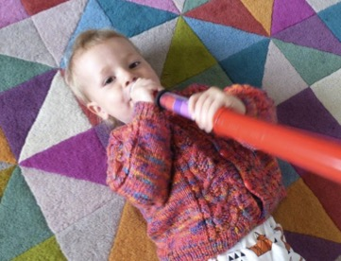
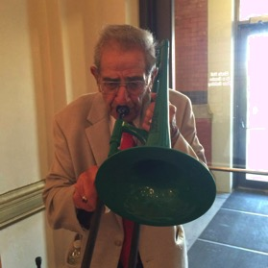
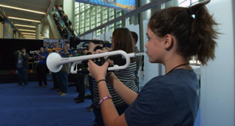
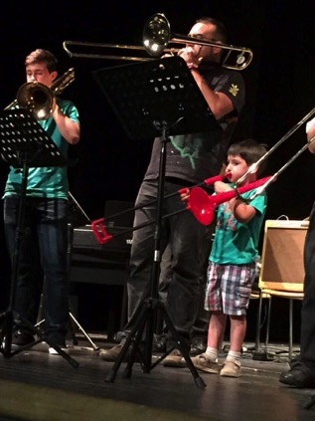
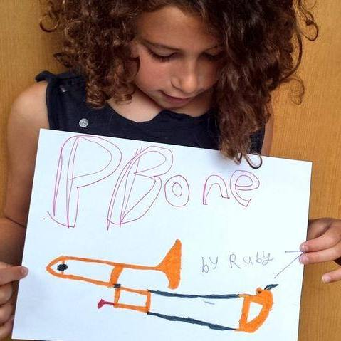
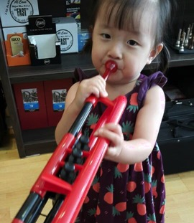
Creating Life Changing Experiences
Origins of Expressions
5
Notes:
When we started in 2007, as teachers and players we were also our customers - evenso we spent a lot of time talking to friends and colleagues in the music world:
Instruments which are light and easy to hold but also robust – suitable for the classroom environment
A unique and distinctive design which is respective of the heritage of the instrument – don’t copy or replace brass
An affordable alternative that gives opportunity to those that can’t afford a (decent!) brass instrument
Something which is fun to play and can be multi-purpose

Slide 6
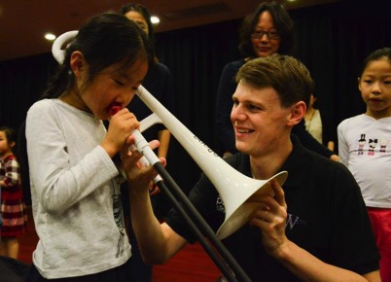
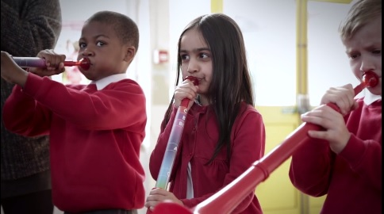
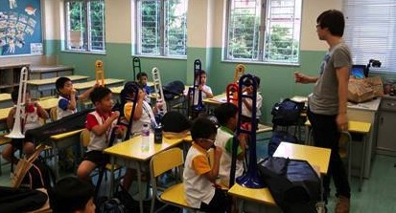
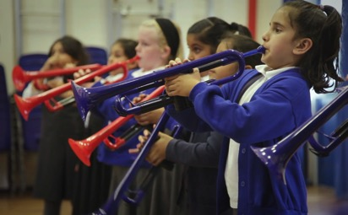
Nurturing the next generation
Caring
Journey
6
Notes:
When we started in 2007, as teachers and players we were also our customers - evenso we spent a lot of time talking to friends and colleagues in the music world:
Instruments which are light and easy to hold but also robust – suitable for the classroom environment
A unique and distinctive design which is respective of the heritage of the instrument – don’t copy or replace brass
An affordable alternative that gives opportunity to those that can’t afford a (decent!) brass instrument
Something which is fun to play and can be multi-purpose

Slide 7
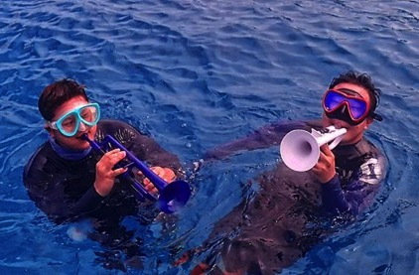

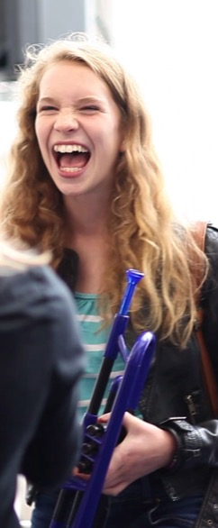
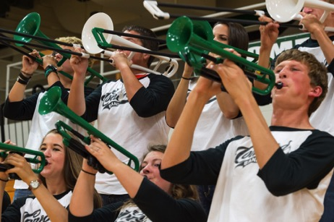
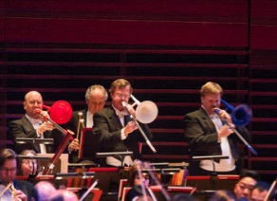
Making Music Fun
Play &
Pleasure
7
Notes:
When we started in 2007, as teachers and players we were also our customers - evenso we spent a lot of time talking to friends and colleagues in the music world:
Instruments which are light and easy to hold but also robust – suitable for the classroom environment
A unique and distinctive design which is respective of the heritage of the instrument – don’t copy or replace brass
An affordable alternative that gives opportunity to those that can’t afford a (decent!) brass instrument
Something which is fun to play and can be multi-purpose

Slide 8
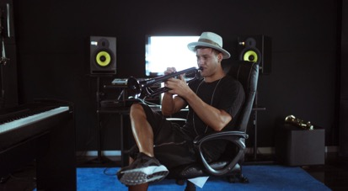
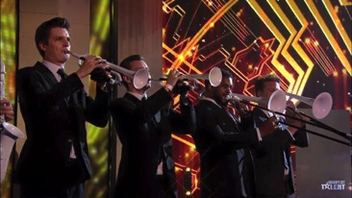
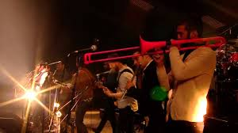
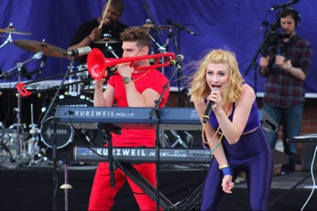
Mass Appeal
Scalable &
Expandable
Timmy Trumpet (DJ) – 757k FB likes, 200m YT views
Britains Got Talent Live Final – 9.7m viewers
Glastonbury 2013, Mumford & Sons
6.2m viewers
Karmin – 1.8m FB Likes, 1.5m YT Subscribers
8
Notes:
When we started in 2007, as teachers and players we were also our customers - evenso we spent a lot of time talking to friends and colleagues in the music world:
Instruments which are light and easy to hold but also robust – suitable for the classroom environment
A unique and distinctive design which is respective of the heritage of the instrument – don’t copy or replace brass
An affordable alternative that gives opportunity to those that can’t afford a (decent!) brass instrument
Something which is fun to play and can be multi-purpose

Slide 9
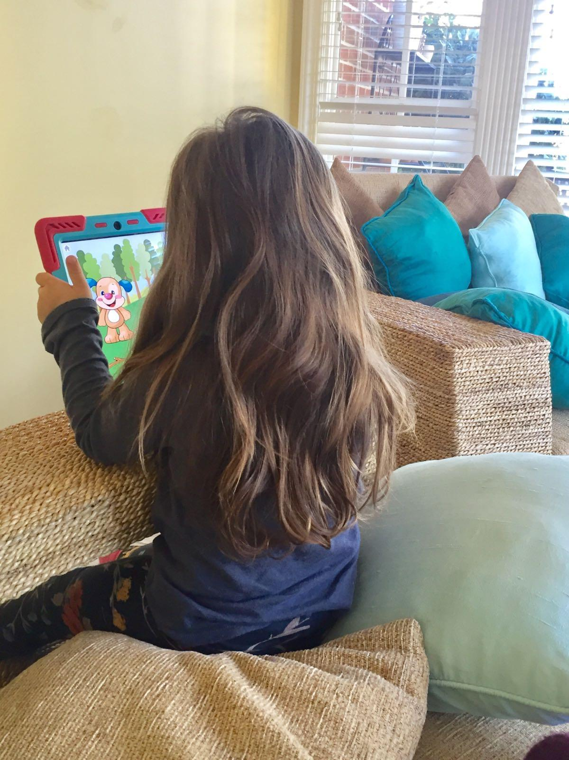
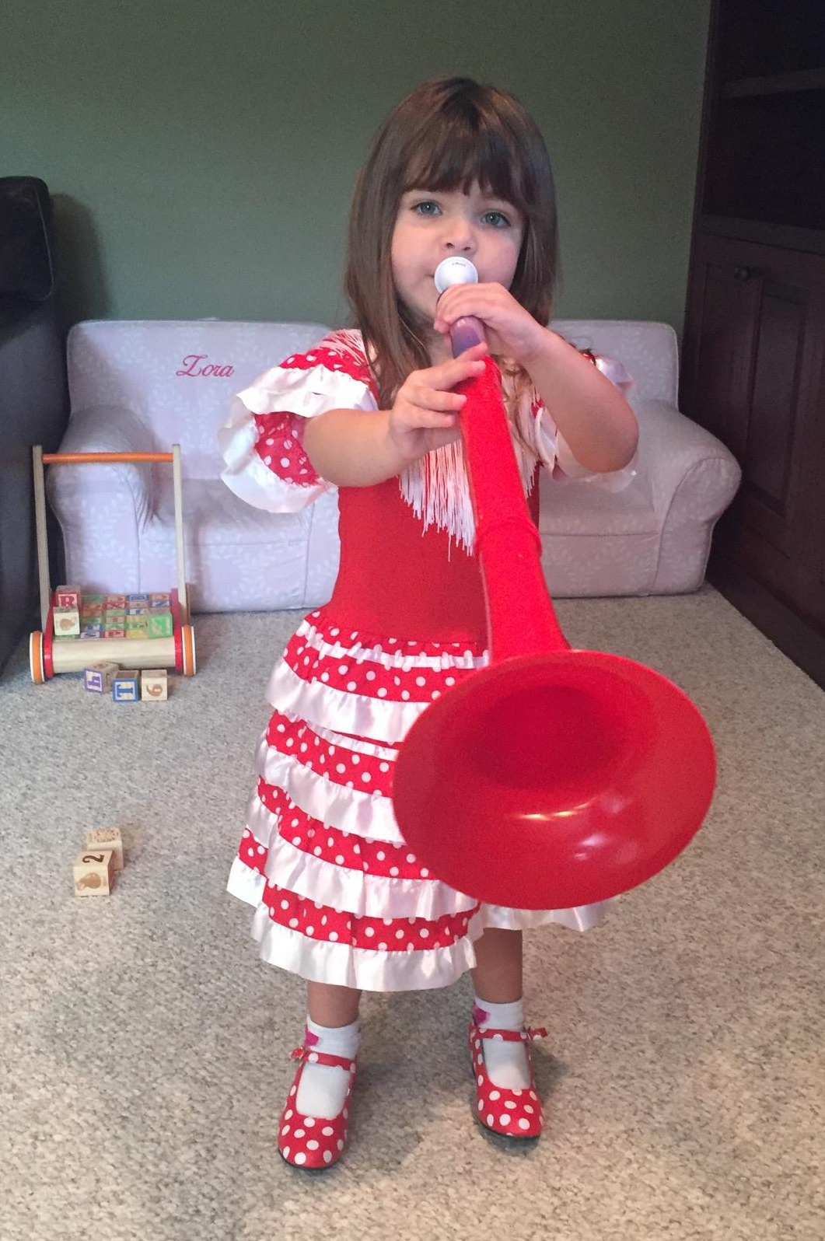
Why ?
Parenthood: Competing for
Attention, Development - Needs, Fun
Balancing
It
All

Slide 10
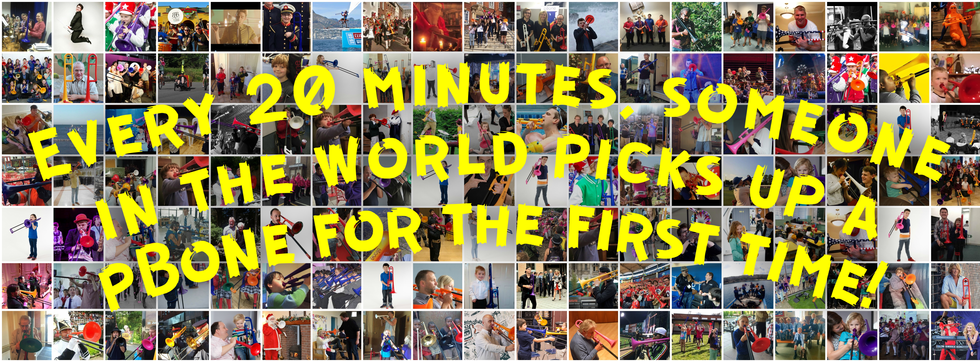
MakeMusicFun@warwickmusic.com
Legacy of Products & Brand

Slide 11
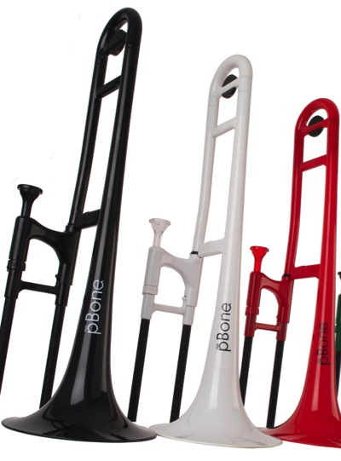
Winning
Scorecard
3 pBones Every Hour for
5 Years
11

Slide 12
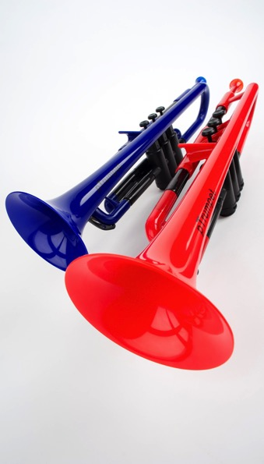
Winning
Scorecard
1.5 pTrumpet
Every Hour for
2 Years
12

Slide 13

Winning
Scorecard
3 pBuzz
Every Hour for
9 Month
13

Slide 14
What have we achieved?
Our
Success
>150k pBones sold in 5 years, now the world’s largest selling trombone
>25k children in UK have started their musical journey with pBand
2.1m engaged community each month on social media
Numerous Music Industry and Innovation Awards globally
Consumer Sales Channels with Walmart, Tesco, Amazon, Shop Direct Group
Brass Trombone sales have grown 15% since 2013
Secured Intellectual Property Rights with granted patents, trademarks and registered design rights
14
Notes:
Bulk discount opportunities
Leads with teachers, school districts

Slide 15
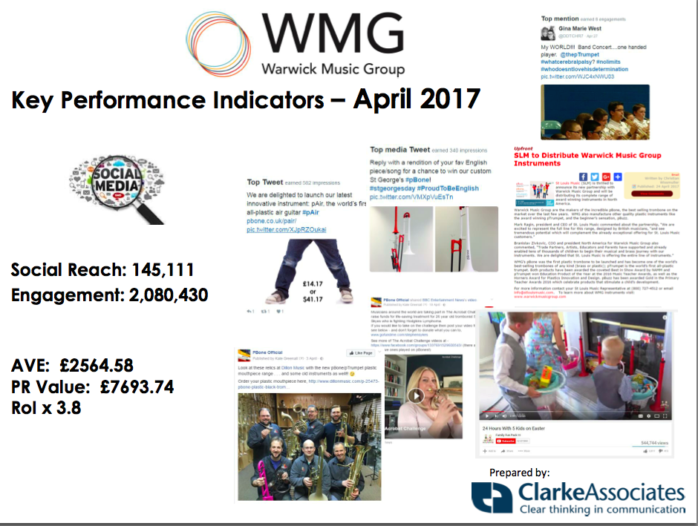
Consumer Reach & Engagement
Building a Community
15

Slide 16



Earning our Unique Right to Win
Fit to Win
Passionate and dedicated team who listen, care and deliver
Award-winning, innovative and patent-protected instruments – that fully utilize the USPs of plastic to improve experiences for consumers and educators
Class leading quality (0.6% QMS Data)
Outstanding customer support based in the UK (NPS>89%)
Educational resources and inspirational content to our community of over 1.8m consumers and educators
Actively collaborate and support our dealers with campaigns
16
Notes:
We make great instruments – that utilize the benefits of plastic
We don’t copy brass – it is made in a completely different way
As teachers and players ourselves we understand the needs of customers
We offer the best quality rates of any supplier to Conn-Selmer
Our products just work out of the box
We won’t stop working until our customers are completely satisfied
We provide outstanding customer support based in the UK
Exclusively staffed by musicians who understand
80% of our customers would recommend our service to others (Amazon.com 64%, Netflix 54%, Apple 72%)
We offer educational resources and inspirational content to our community of over 80k people and growing daily
We support our brand with global marketing initiatives
We collaborate and support our dealers
we don’t compete with them

Slide 17
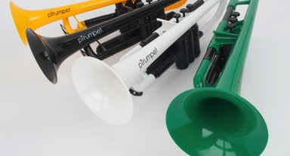
Compared to our competitors
Brass instruments
pInstruments more durable, less prone to damage, and lighter/easier to hold, low maintenance
Tromba (Allora OEM)
pInstruments are better build quality, better design and globally recognized brand
Cool Winds
pInstruments are more affordable, better build quality, better design and globally recognized brand
17

Slide 18
Growing the base of musicians
US Pre Band
Base Growth
pBand ideal for pre-Band
Low cost
Lightweight
Robust
No maintenance
Easy Access
Fun
Band
6^{th+} Grade
pBone / pTrumpet
4th – 6th Grade (12.2m)
pBone mini / pCornet
1st – 3rd Grade (12.3m)
pBuzz
Pre – K (8.8m)
US School Population
Pre-6: 33m
5-11 years old
School Brass Sales: 234k units p.a. = 0.8%
pBand: making music fun
18
Notes:
Bulk discount opportunities
Leads with teachers, school districts

Slide 19
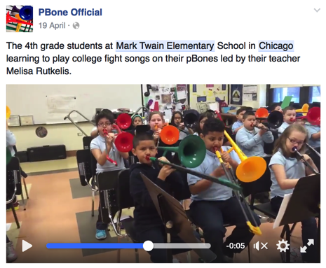
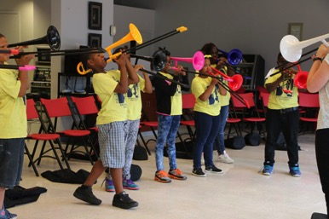

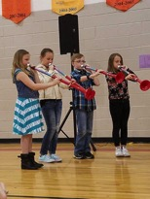
pBand at work in American schools
Incremental
Reach
As part of The Cleveland Orchestra’s Neighborhood Residency in Hough this summer, students at the Fatima Family Center learn to make music with pBones! (August 2016)
“pBones are an awesome way to incorporate traditional band instruments into modern band lessons for any level of player” Melisa Rutkelis - Music Teacher, Mark Twain Elementary School
Lotus Elementary, Illinois, Paul Hefner
Contemporary Music ( One Direction- Tracks)
High school paid for Instruments
19
Notes:
Bulk discount opportunities
Leads with teachers, school districts

Slide 20




Quality in Manufacture
Demanding
Excellence
Since 2011, we have exclusively used automotive suppliers certified to ISO9001 & TS-16949
We have 1 full-time employee based in China focused solely on quality
20
Notes:
Bulk discount opportunities
Leads with teachers, school districts

Slide 21
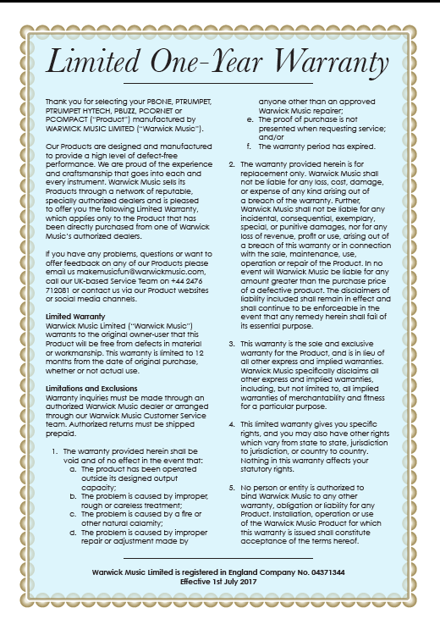
Warranty & Questions
Quantifiable
Measures
Anytime:
Makemusicfun@warwickmusic.com
Please add image, serial number and
Mailing address.
We have very very few issues, so
We can afford to replace
the instruments.
21

Slide 22
Quality in Service
Customers
First
We replace and ship all warranty and non-warranty claims worldwide free of charge from the UK
We do not need to provide any spare parts or servicing support to dealers
Net Promoter Score (customer service) 89%
"My son is disabled, stroke in utero...drs gave him a grim prognosis but he prevailed.....in forth grade he signed himself up for band!!! LOL....trumpet...played one handed but it was so heavy....AS SOON as the pTrumpet was released for US, we bought one.....he is in 6th grade and playing like a champ....ONE HANDED....it is light enough!!!” Facebook Message (Apr 2017)
“Thank you very much for your fast response...I thank you for helping me get my pTrumpet back up and running, I really enjoy the horn. I am going to recommend that everyone I know buy a pTrumpet.” Michael A. (Mar 2017)
”What incredible customer service. I don't know what to say. Except thank you and thank you again.” Julie P. (Feb 2017)
22
Notes:
Bulk discount opportunities
Leads with teachers, school districts

Slide 23
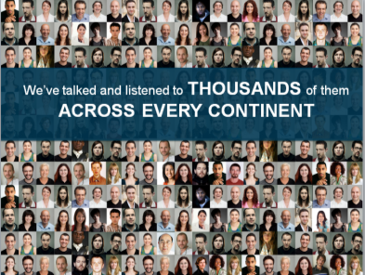



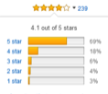

Net Promoter Scores
Quantifiable
Measures
 | pBuzz | pBone | pTrumpet
Net Promoter Scores | +81% | +68% | +36%
Amazon.com
Facebook Engagement (April -17) | 2.1 m
23

Slide 24


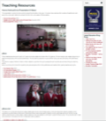
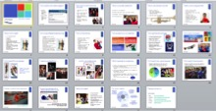
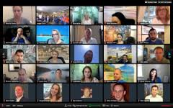
Supporting Sell through
Collaborate
to Win
Dealer / Educator Focus
B2C Activities
New Channels
Opportunity Validation &
Business Development
Increasing Purchase considerations
1. Trade Shows (NAMM
NAFME/ TMEA)
2. TMEA Past President
3. 1 x 1 Support
1. Smart Merchandising
2. Targeted Promotions
3. Differentiated Offering
Existing Channels Productivity & Penetration
Expanding Awareness
Perfect Pitch
Webcasting
1. Facebook live
Engaged social community
2. Start your Own Legacy
3. Education Support
4. pInstruments CIRCLE
24

Slide 25
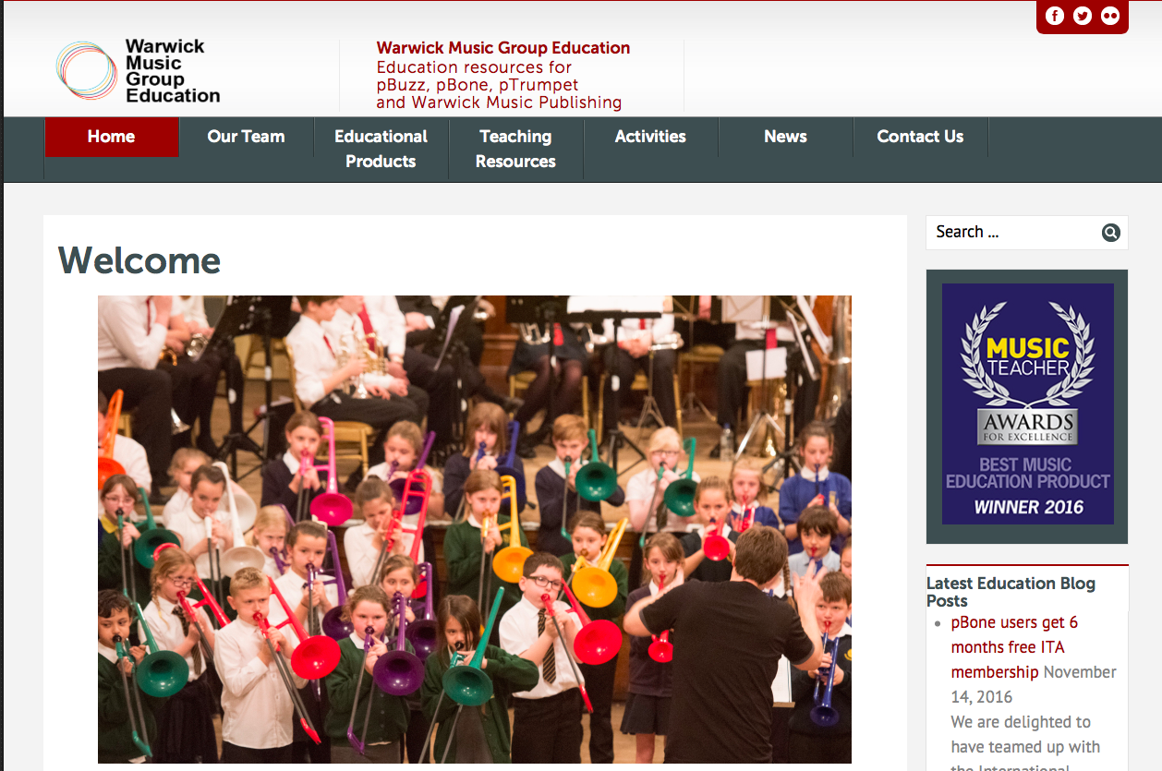
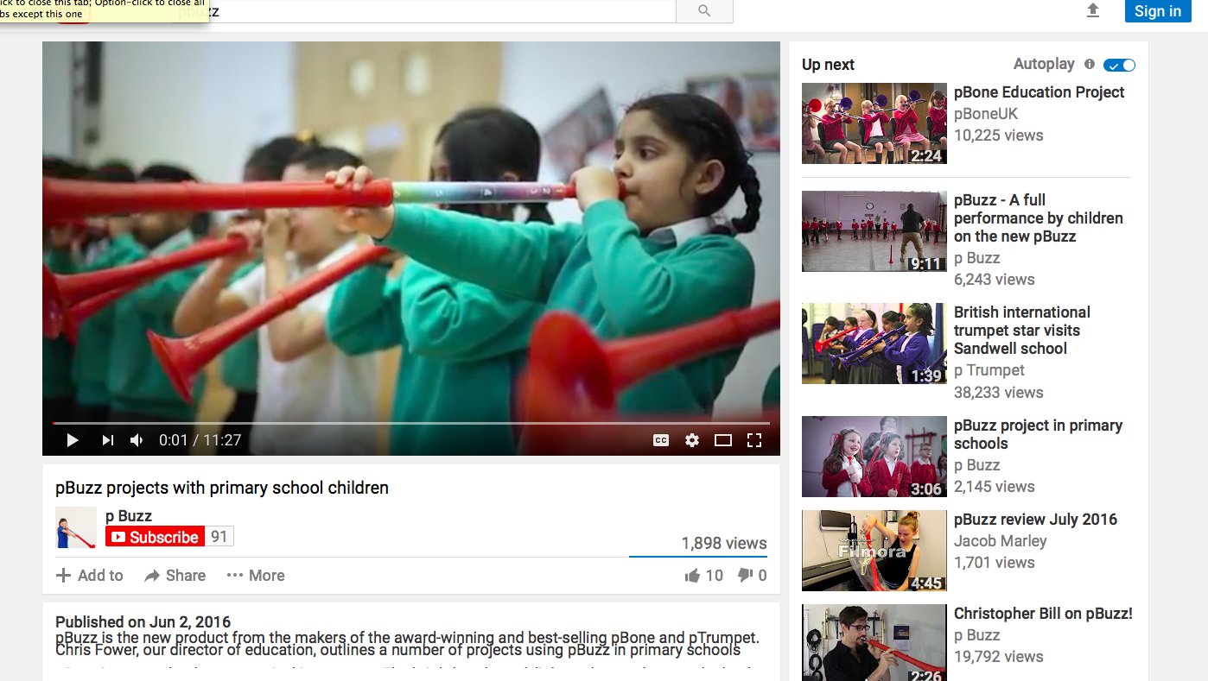
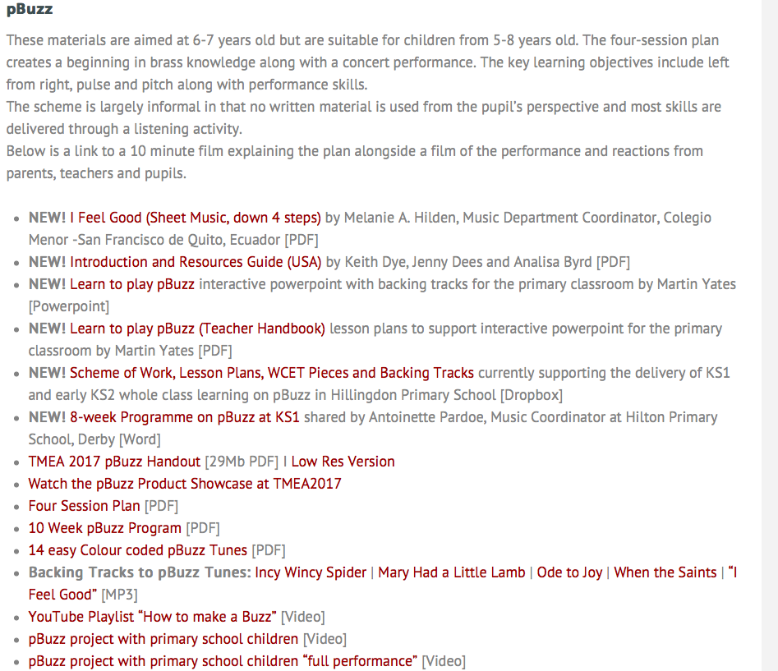
Education Resources
World class
Knowledge
Videos
Library
Resource
Guides
25

Slide 26
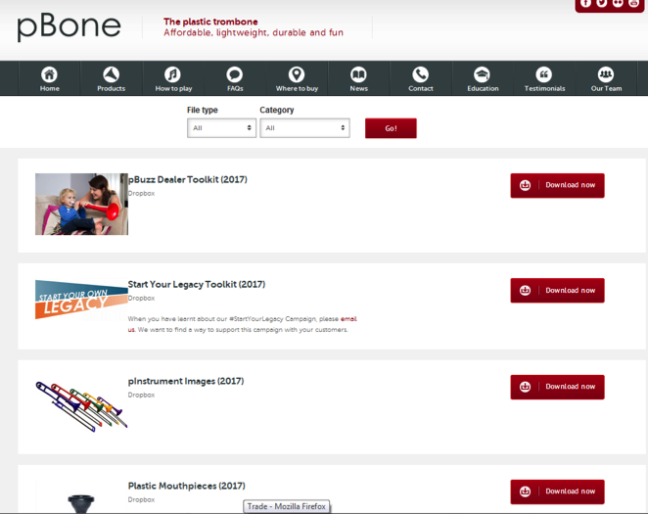
Trade Partner Landing Page
World class
Presentations
26

Slide 27
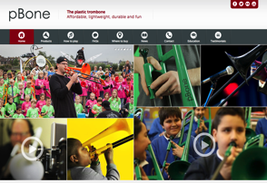
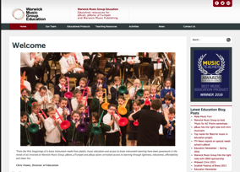
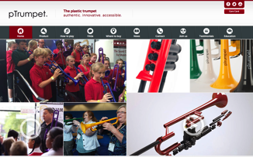
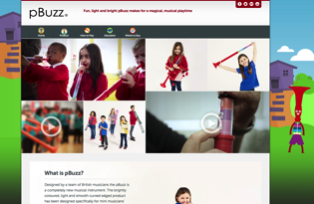
Websites
Digital
Presence
pbone.co.uk
education.warwickmusicgroup.com
ptrumpet.com
pbuzz.co.uk
27

Slide 28
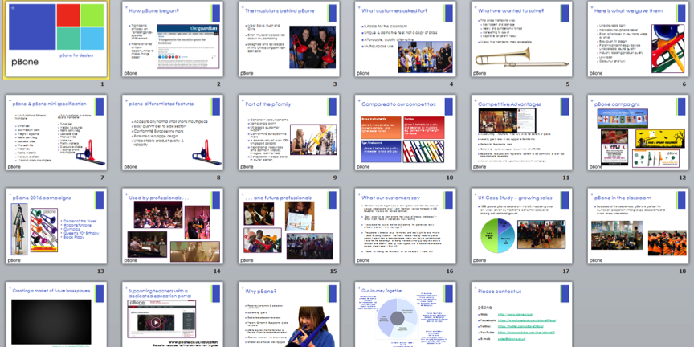
Dealer & Educator Presentations (available for all instruments)
World class
Presentations
28

Slide 29
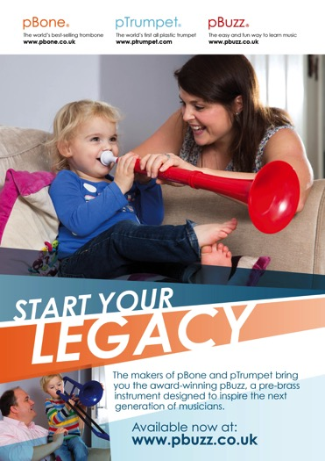
Start Your Legacy Campaign
Communication
Campaign
Target Audience:
Musicians, Brass & Woodwind
Awareness/Reach:
Dealers Email list
Facebook/Social Media
29

Slide 30







Awards
International
Recognition
30

Slide 31
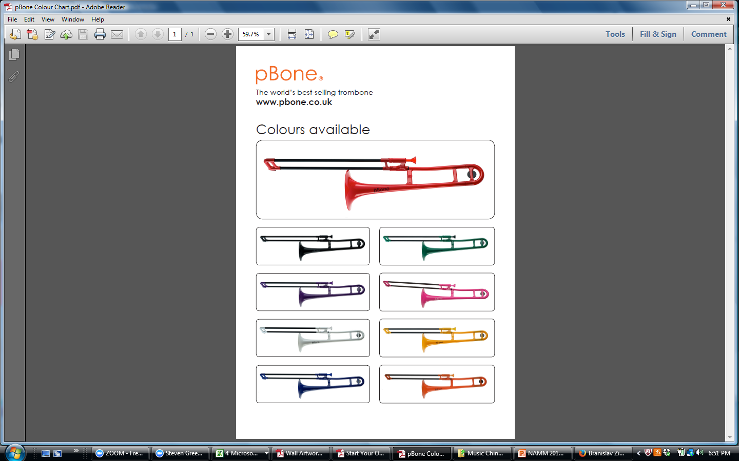

Today:
Going
Forward
Get your Own: pBone/ pTrumpet or pBuzz
31
Notes:
National Foundation for Youth Music, funded by the UK Government, declared the trombone to be an “endangered species”

Slide 32
Proposed steps:
Going
Forward
Questions
How do we help you in class room?
Funding?
Build the next generation of Brass Players?
32
Notes:
National Foundation for Youth Music, funded by the UK Government, declared the trombone to be an “endangered species”

Slide 33
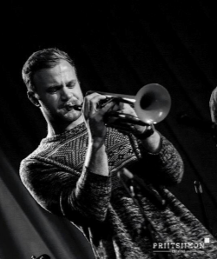
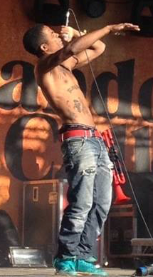
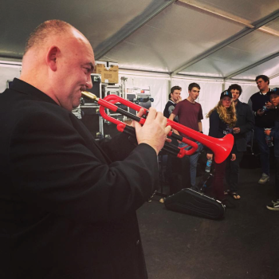

Used by professionals . . .
Legitimized
& Endorsed
33

Slide 34



. . . and future professionals
Advancing
pre Band Base
34

Slide 35

pBuzz l pBone l pTrumpet l just play!
35
Notes:
Instruments which are light and easy to hold but also robust – suitable for the classroom environment
A unique and distinctive design which is respective of the heritage of the instrument – don’t copy or replace brass
An affordable alternative that gives opportunity to those that can’t afford a (decent!) brass instrument
Something which is fun to play and can be multi-purpose

